Slide 1

Health App
GitHub Repository Structure
Team 4

Slide 2

GitHub URL
https://github.com/fitness-health-app/health-app

Slide 3
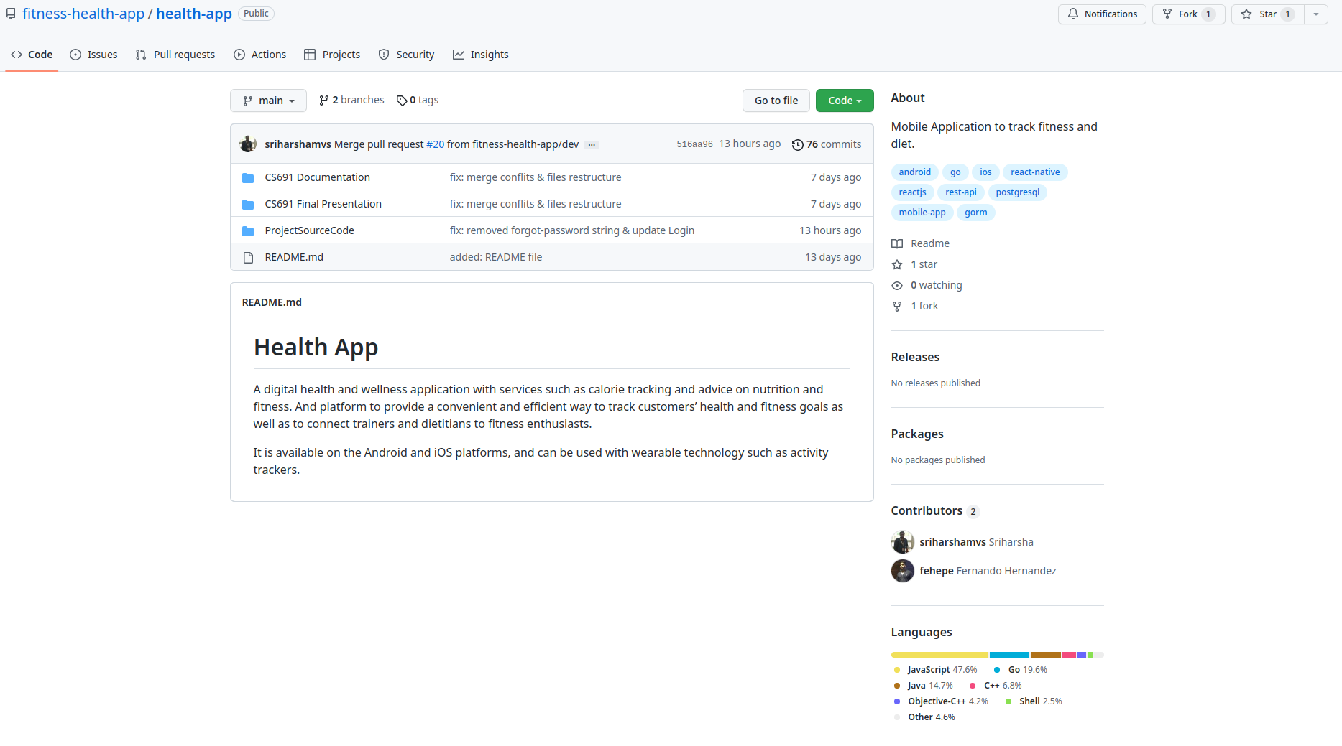
Repository Structure

Slide 4
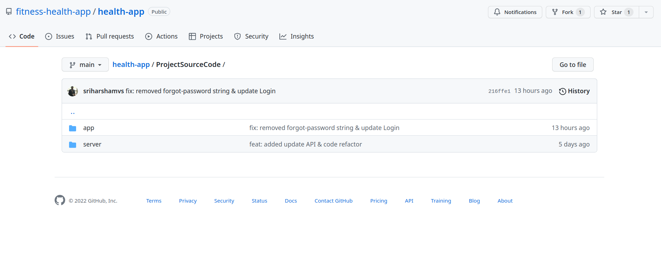
Repository Structure

Slide 5
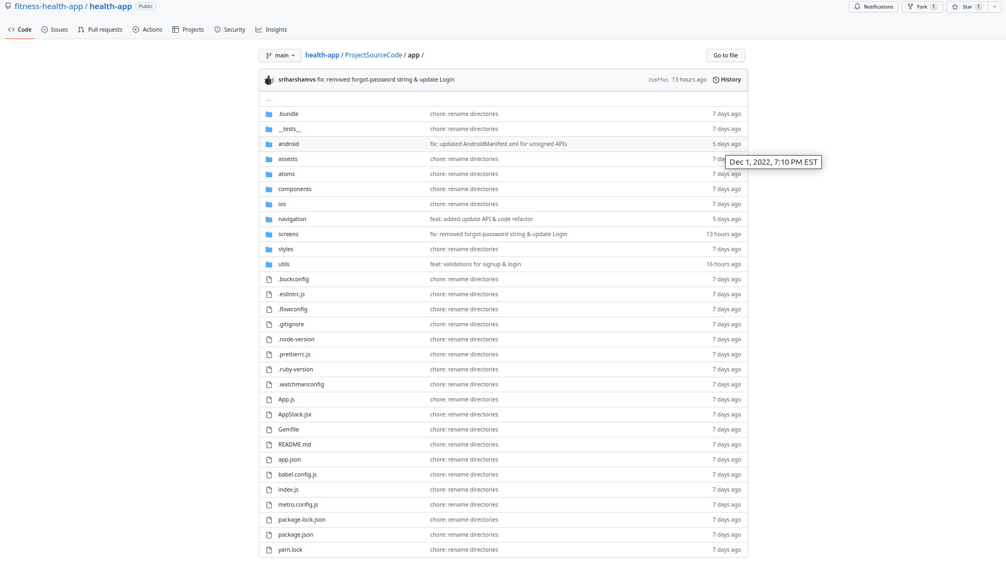
Repository Structure (App – Client – Frontend)

Slide 6
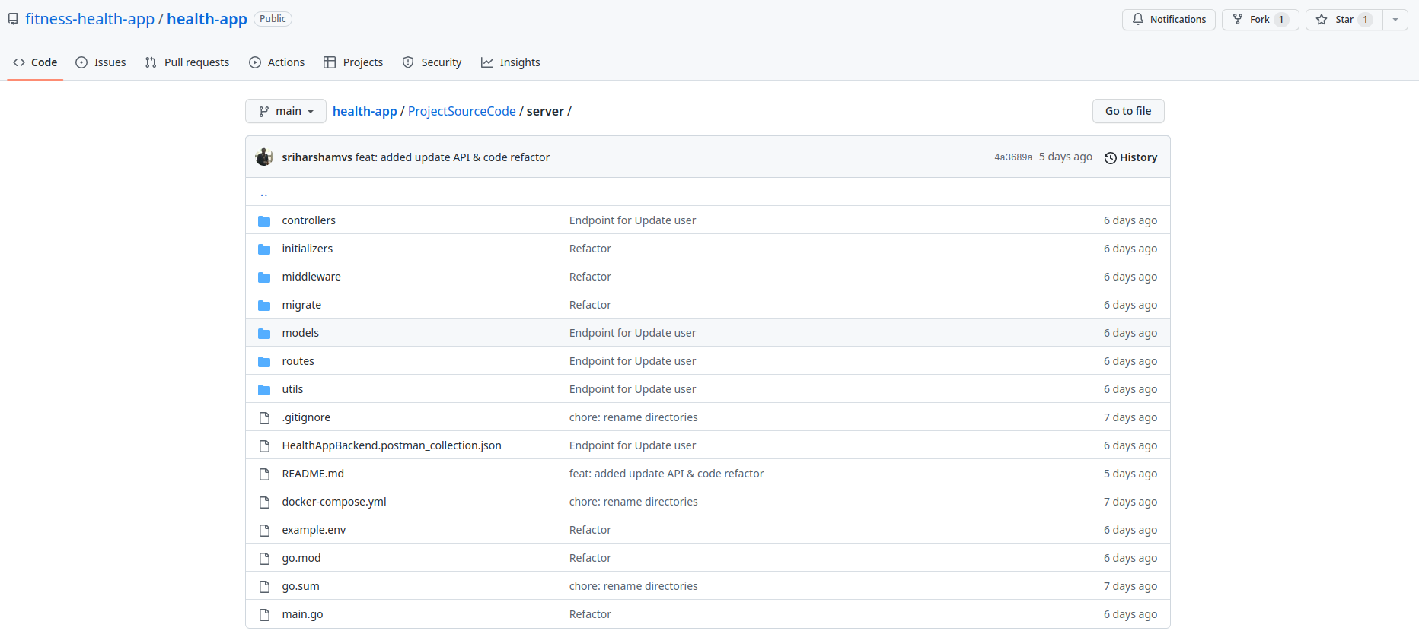
Repository Structure (server – Backend)

Slide 7
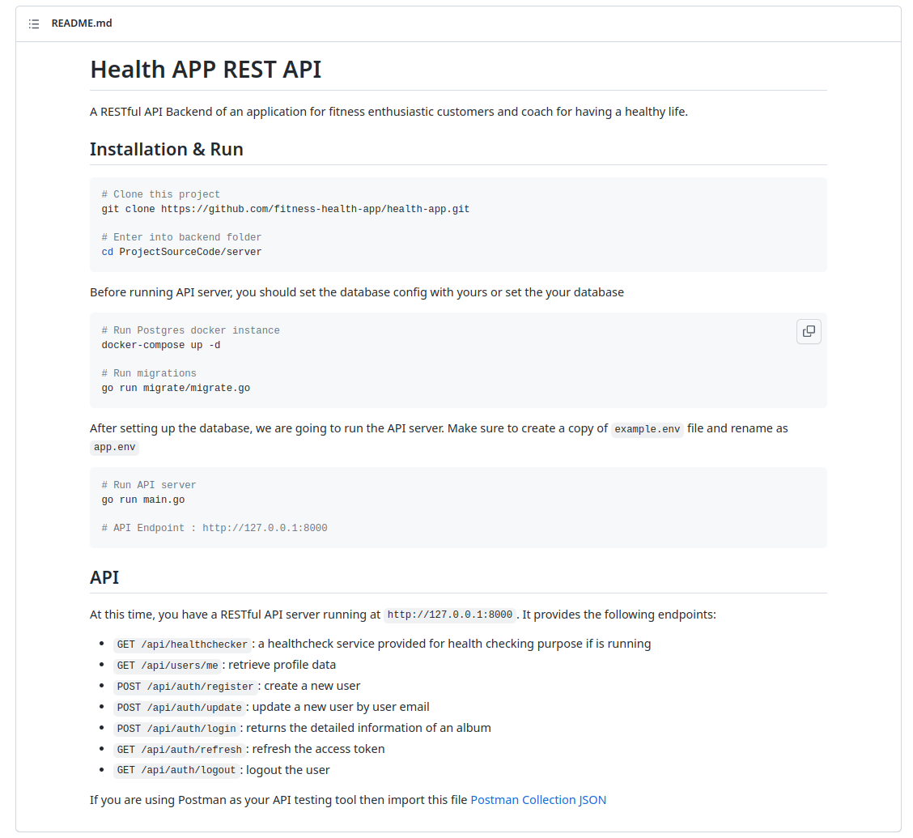
Build & Deployment Procedures(server – Backend)

Slide 8
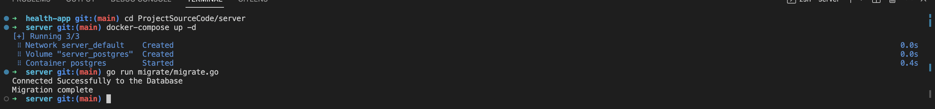
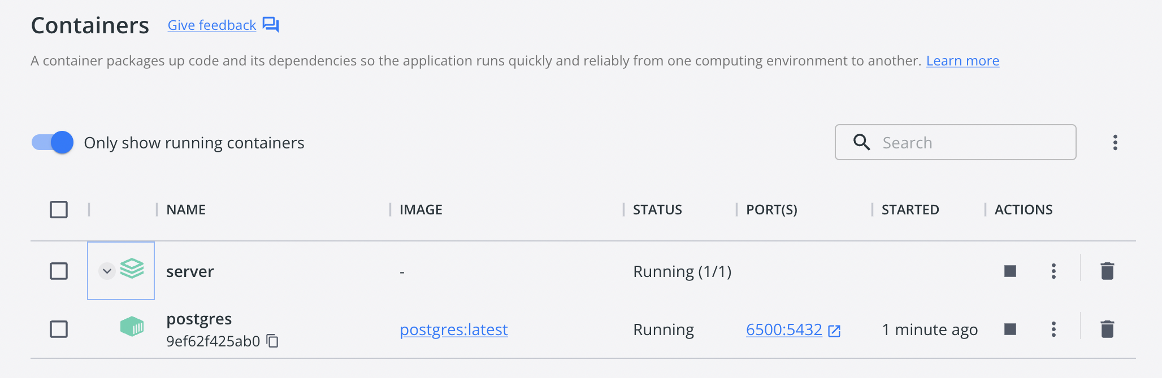
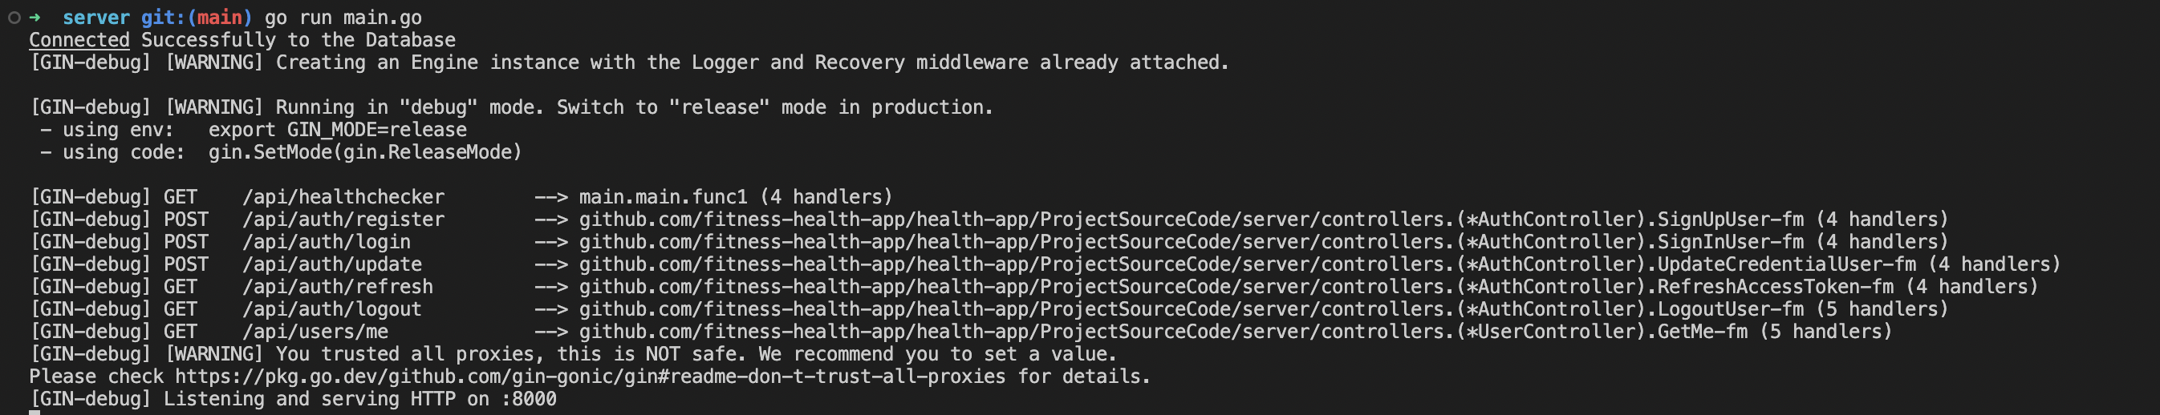
Build & Deployment on Local Procedures(server – Backend)

Slide 9
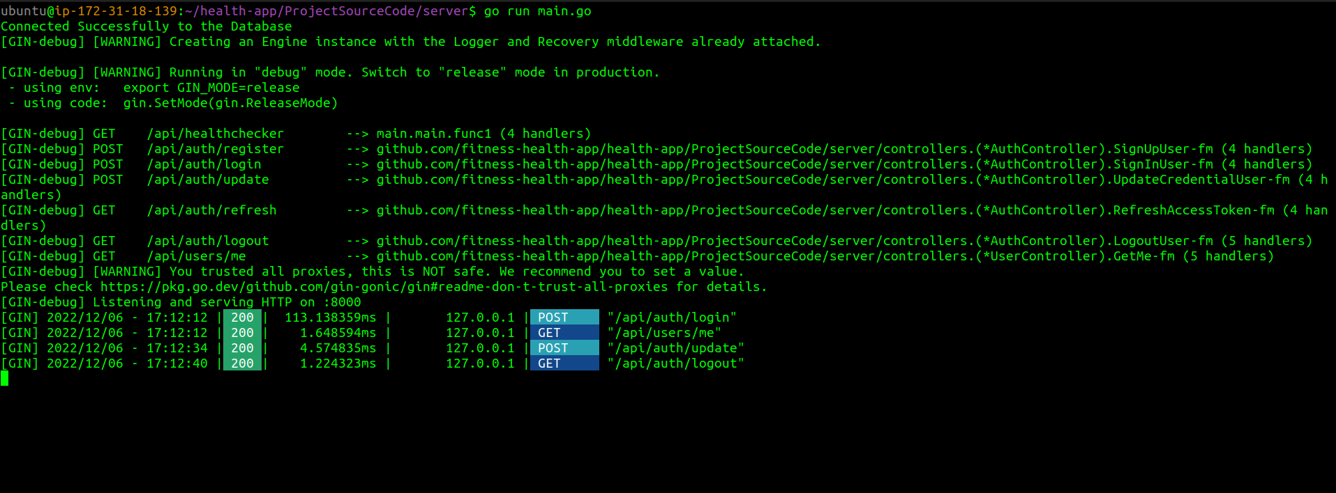





Build & Deployment on AWS Procedures(server – Backend)

